Slide 1
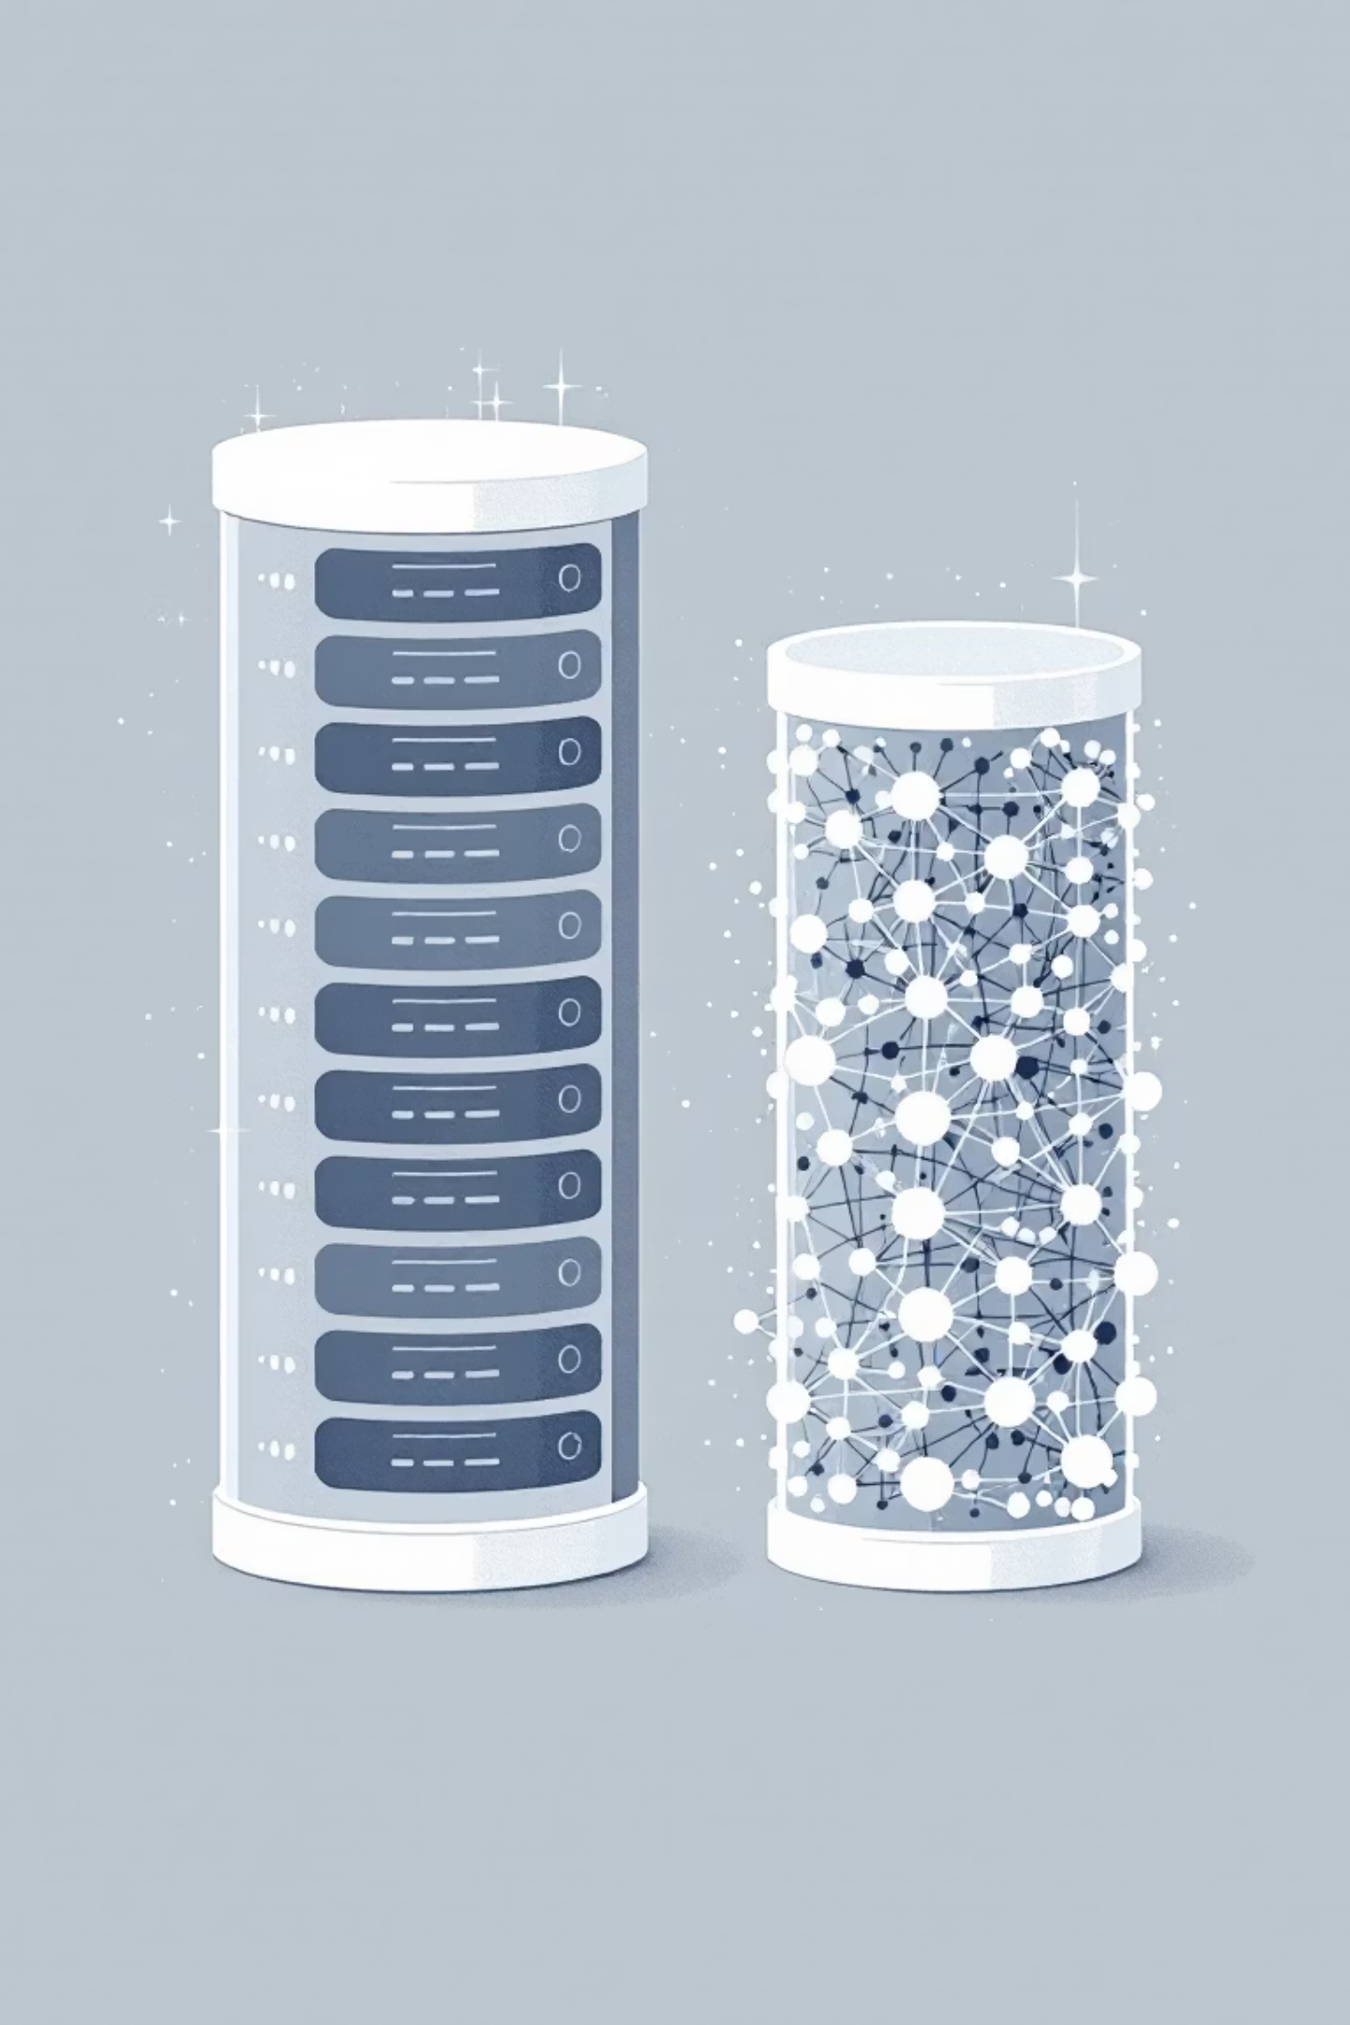

The Shift from Traditional to Gen AI Databases
Generative AI applications require a fundamentally different approach to storing and retrieving data compared to traditional applications. This presentation explores why vector embeddings are crucial and what factors to consider when choosing a Gen AI database.
dfdsf
Notes:
**(Slide Title: The Shift to Gen AI Databases)**
Good morning/afternoon. Traditional databases aren't cut out for Generative AI. Gen AI needs a fundamentally new approach to data. This presentation will show you why vector embeddings are key, and what's critical when selecting the right Gen AI database for your needs.

Slide 2

Traditional vs. Gen AI Databases
Traditional Databases
Gen AI Databases
Store structured data in rows and columns
Handle unstructured data (text, images, audio)
Find data by matching exact values
Understand meaning and context
SQL queries for precise matches (e.g., "find all carnivores")
Find semantically similar items
Rely on vector embeddings
dfdsf
Notes:
Slide Title: Traditional vs. Generative AI Databases
**(Speaker Notes):** This slide contrasts traditional and generative AI databases. Traditional databases excel at structured data, using SQL for precise queries (e.g., finding all carnivores). Generative AI databases, however, handle unstructured data like text and images. Their key advantage is semantic search—finding similar items based on meaning and context, leveraging vector embeddings. This unlocks entirely new possibilities for data analysis and retrieval. (Ignore the 'dfdsf' – likely a typo).

Slide 3



What Are Vector Embeddings?
A vector embedding converts unstructured data—like words, sentences, or images—into a list of numbers (a vector) representing its position in a high-dimensional space.
Unstructured Data
Embedding Process
Vector Database
Text, images, audio files
Convert to numerical vectors
Store in high-dimensional space
The key feature: semantically similar items are placed closer together in this space. For example, "lion" and "tiger" vectors would be close, while "car" would be far away.
dfdsf
Notes:
Slide Title: What are Vector Embeddings?
Speaker Notes: We're transforming unstructured data – text, images, audio – into numerical vectors. This process creates a high-dimensional space where semantically similar items cluster together. Think "lion" and "tiger" being close, "car" being distant. This allows us to use vector databases for efficient similarity searches.

Slide 4

Semantic Search with Vector Embeddings
Traditional Search
Semantic Search
"Find the animal named 'lion'"
"Find animals similar to a 'lion'"
Exact match required
Returns tigers, leopards, cheetahs
Misses related concepts
Understands relationships
Limited to structured data
Works with unstructured data
dfdsf
Notes:
Slide Title: Semantic Search vs. Traditional Search
**(Speaker Notes):** This slide contrasts traditional keyword-based search with semantic search leveraging vector embeddings. Traditional search relies on exact keyword matches, missing related concepts and limiting results to structured data. Notice the "lion" example – it only finds "lion." Semantic search, however, understands context and relationships, allowing for broader, more relevant results. See how the same query, rephrased, returns related animals like tigers, leopards, and cheetahs. This capability extends to unstructured data, offering significant improvements in search accuracy and user experience.

Slide 5
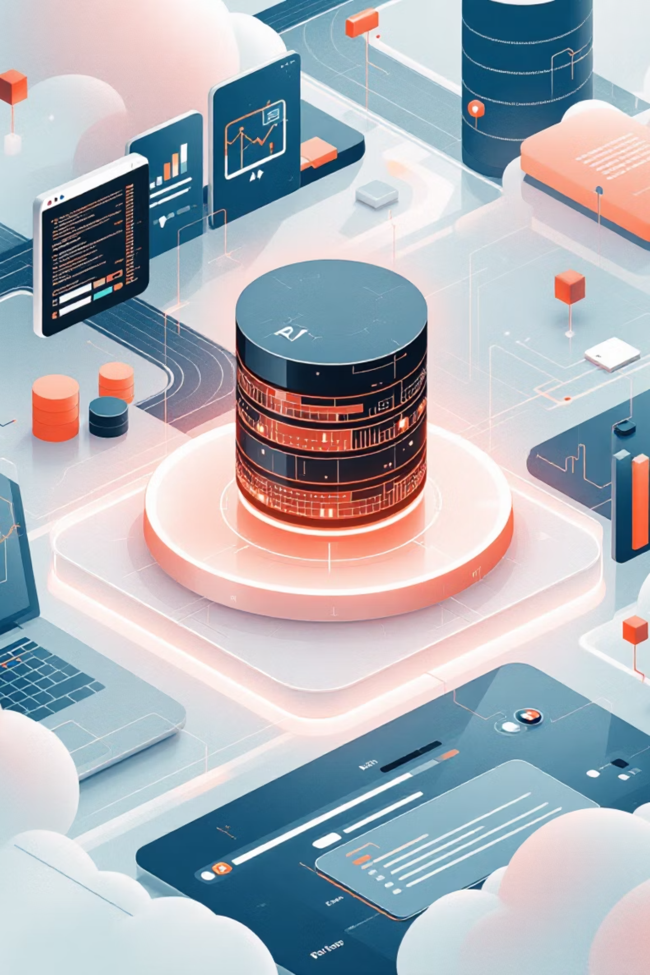
Key Factors for Choosing a Gen AI Database
Support for Vector Search
Database must efficiently store vectors and perform fast similarity searches
Examples: AlloyDB, Spanner, and Cloud SQL for PostgreSQL
Integration with AI/ML Platforms
Should connect easily with AI platforms like Google's Vertex AI to simplify creating embeddings and using foundation models
dfdsf
Notes:
Slide Title: Selecting the Right Gen AI Database
**(Speaker Notes):** This slide highlights crucial factors when choosing a database for generative AI. We need robust **vector search** capabilities – efficient storage and fast similarity searches are essential. Consider options like AlloyDB, Spanner, and Cloud SQL for PostgreSQL. Equally important is seamless **integration with AI/ML platforms** such as Google's Vertex AI, simplifying embedding creation and foundation model usage. This integration streamlines the entire AI workflow.

Slide 6



Scale and Performance
Gen AI deals with enormous datasets and requires rapid responses.
AlloyDB
Spanner
Memorystore
Extremely fast queries (transactional, vector, and analytical)
Scales almost infinitely to handle global traffic and massive datasets, ideal for large language models
In-memory storage for caching, offering fastest possible data access for frequently used information
dfdsf
Notes:
Slide: Scale & Performance
**Speaker Notes:** Gen AI's success hinges on handling massive datasets and delivering rapid responses. Our solution leverages Google Cloud's powerful services: AlloyDB for blazing-fast transactional, vector, and analytical queries; Spanner for virtually limitless scalability to manage global traffic and huge datasets ideal for LLMs; and Memorystore for in-memory caching, guaranteeing the fastest access to frequently used data.

Slide 7
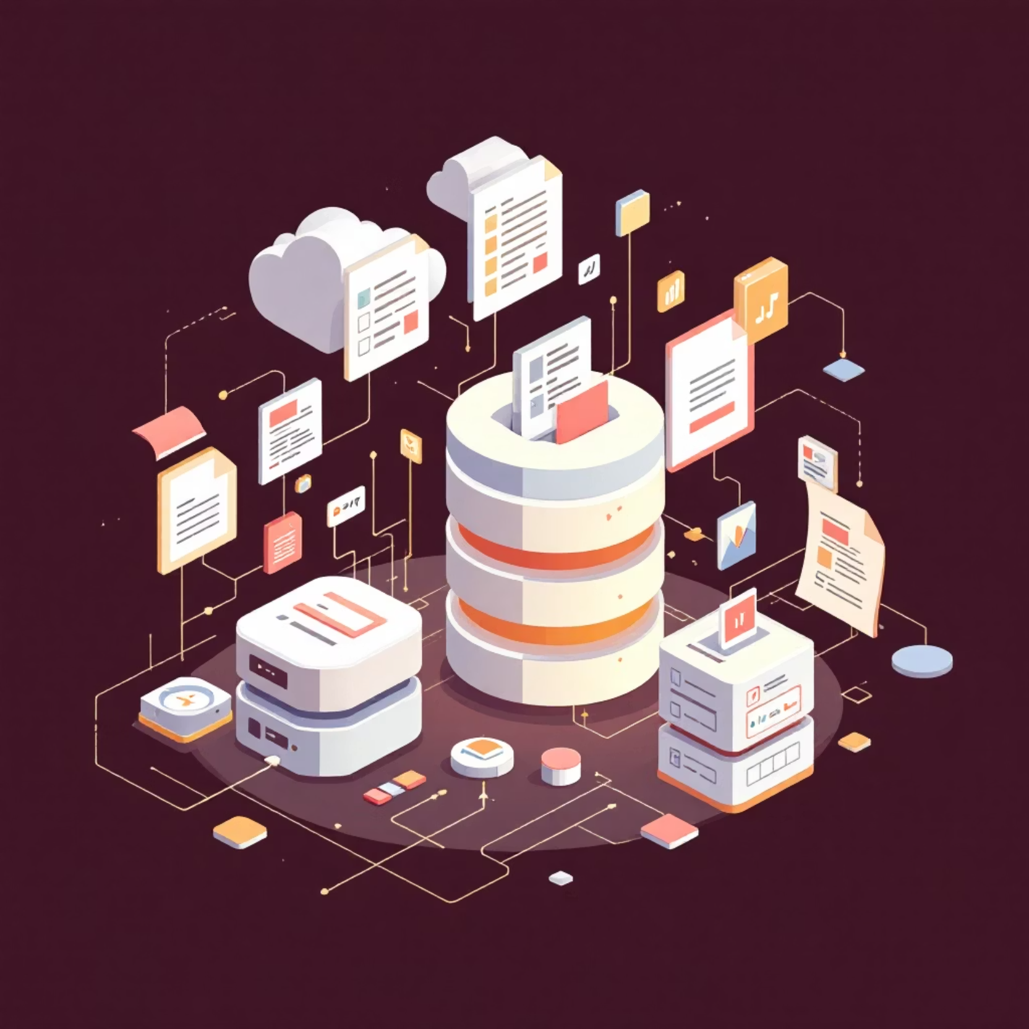
Data Flexibility
Gen AI applications often use diverse data types:
BigQuery
Best for analyzing petabyte-scale structured and semi-structured datasets
Firestore
Great for flexible, document-style data (unstructured or semi-structured) requiring real-time updates
dfdsf
Notes:
Slide Title: Data Flexibility in Gen AI
Speaker Notes: Our Gen AI applications leverage diverse data sources for optimal performance. BigQuery excels with massive, structured data sets – think petabytes. For flexible, real-time needs and document-style data, Firestore provides a superior solution. [Note: Address "dfdsf" – likely a placeholder, remove or replace before presentation.]

Slide 8


Cost and Operational Efficiency
Storing huge amounts of data can be expensive.
Fully-managed databases like AlloyDB and Cloud SQL reduce the need for manual administration, which lowers operational costs.
When choosing a Gen AI database, consider both direct storage costs and the hidden costs of administration and maintenance.
dfdsf
Notes:
**Slide: Cost and Operational Efficiency**
**Speaker Notes:** High data volumes translate to significant storage costs. Fully managed solutions like AlloyDB and Cloud SQL minimize operational expenses by automating administration and maintenance. Don't just focus on raw storage costs—account for the hidden costs of managing your database when selecting a Gen AI solution.

Slide 9

Security and Data Protection
Encryption
Access Control
Advanced Security
Databases like AlloyDB, Cloud SQL, Spanner, and Firestore automatically encrypt data both at rest and in transit
Integration with IAM (Identity and Access Management) lets you control exactly who can see or modify data
AlloyDB provides extra features like model endpoint management to protect your application from malicious attacks
dfdsf
Notes:
This slide highlights our robust security and data protection measures. We leverage automated encryption (at rest and in transit) across databases like AlloyDB, Cloud SQL, Spanner, and Firestore. Granular access control, integrated with IAM, ensures only authorized users can access and modify data. Furthermore, advanced security features in AlloyDB, such as model endpoint management, mitigate malicious attacks.

Slide 10
Key Takeaways
Different Needs, Different Solutions
Choose the Right Database
Vector Embeddings Are Essential
Consider vector search support, AI integration, scale, flexibility, cost, and security
AlloyDB, Spanner, BigQuery, and Firestore each excel in different Gen AI scenarios
They enable semantic search and understanding of unstructured data
The shift to Gen AI databases represents a fundamental change in how we store, retrieve, and understand data.
dfdsf
Notes:
Slide Title: Key Takeaways: Embracing Gen AI Databases
* **Vector embeddings are crucial:** Enable semantic search & understanding of unstructured data.
* **Database selection is key:** Prioritize vector search, AI integration, scalability, flexibility, cost & security.
* **Diverse solutions for diverse needs:** AlloyDB, Spanner, BigQuery, & Firestore each offer unique strengths for Gen AI.
* **Fundamental shift:** Gen AI databases redefine data storage, retrieval, and understanding.

